Slide 1


Chapter III - 2025
COPYRIGHT (C) 2025, ECLIPSE FOUNDATION

Slide 2
PITCHING SESSION Porto Motive
COPYRIGHT (C) 2025, ECLIPSE FOUNDATION

Slide 3

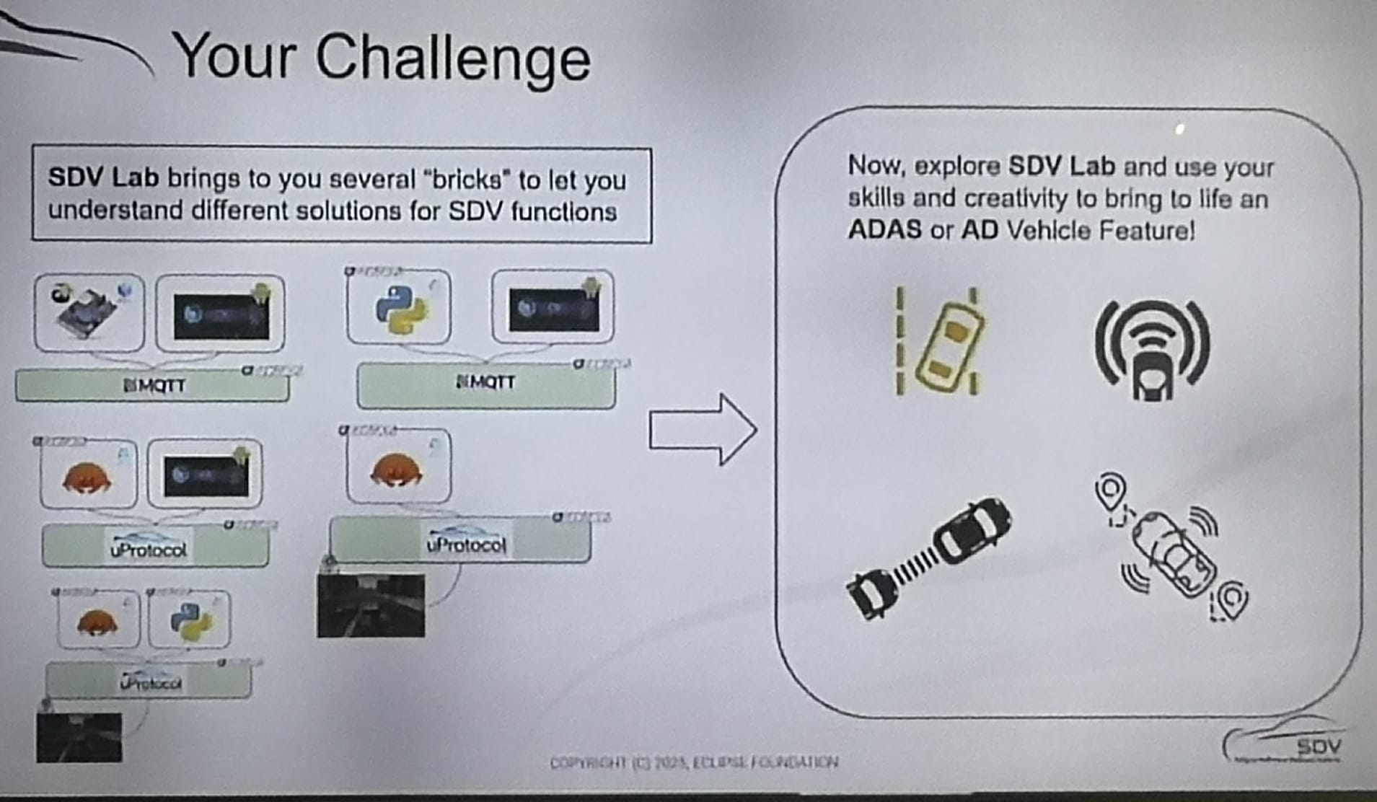
The Plan
We chose the SDV Lab.
Initial Situation At the Hackathon Eclipse SDV – Chapter Three, we were challenged to choose between two different tracks:
Software-Defined Vehicle (SDV) Lab
Mission: Update Possible
Why? Because, having no prior experience in the automotive field, it seemed:
1. more intuitive for us to start with this challenge. 2. From a learning perspective, it also felt more logical to first understand how to implement car features before moving on to the update challenge (i.e., learn first, update later).

Slide 4

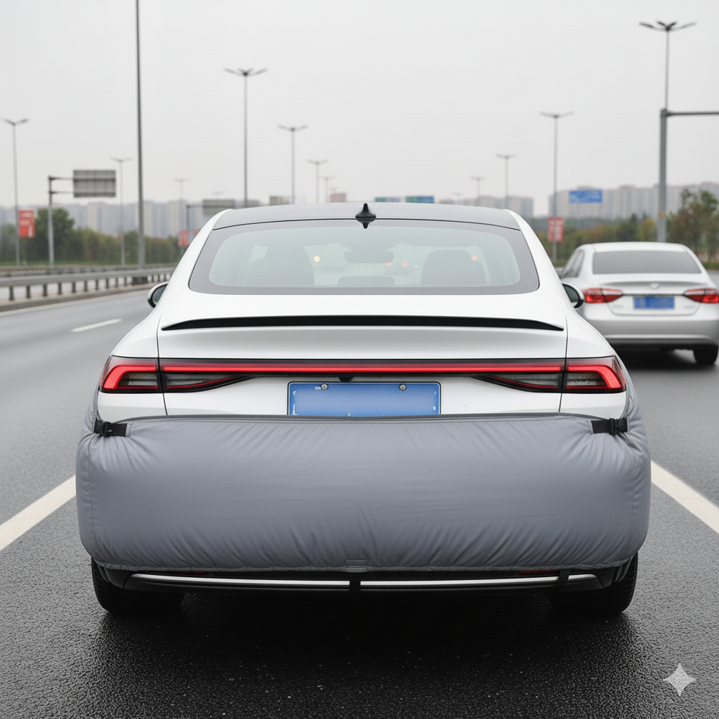

The Plan
Main Ideas
Prevent rear-end collisions by detecting when a vehicle approaches at high speed and effectively applying evasive maneuvers.
Reduce the effects of collisions if they are emminent (especially in traffic jams) by redistributing the impact across the queue of vehicles, using the same principle as Newton’s cradle, ultimately saving lives, which is our primary goal.
1. We will implement an adaptive Rear Collision Evasion System (RCES) as a proof of concept, named Backward Automotive Life-Saving System (or B.A.L.S.).
2. To achieve this, we used CARLA (the open-source driving simulator) and designed an algorithm that uses RADAR to detect vehicles approaching from behind. The system will then automatically trigger an evasive maneuver, deviating the car to the left or right (depending on available space).

Slide 5
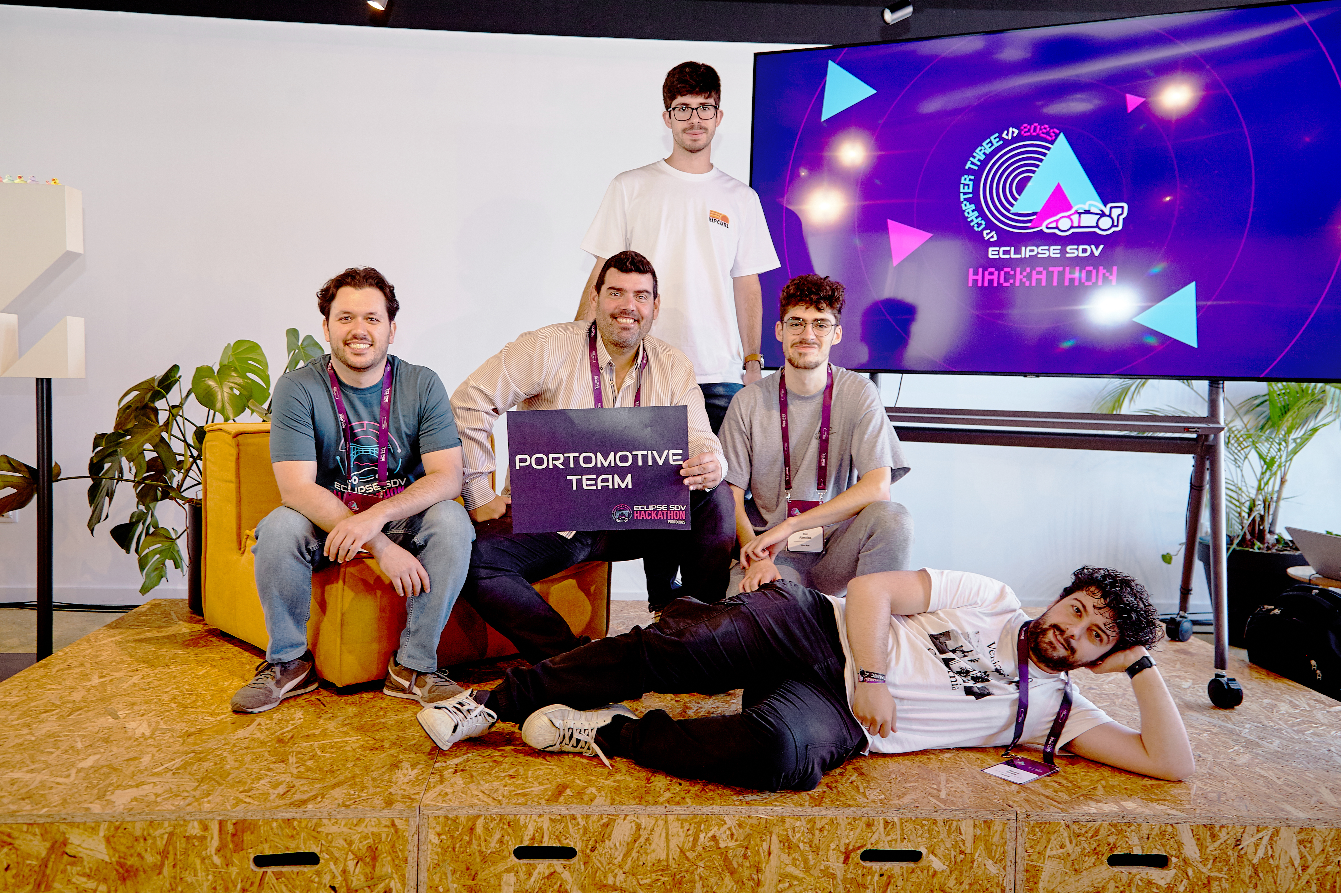
Team and Structure
Name | Role(s)
Bruno Miguel | Brainstormer
Rui Almeida | Developer
Miguel Biltes | Developer
João Silva | P.M. Developer
Bernardo Esteves | Conceptualization Architect

Slide 6
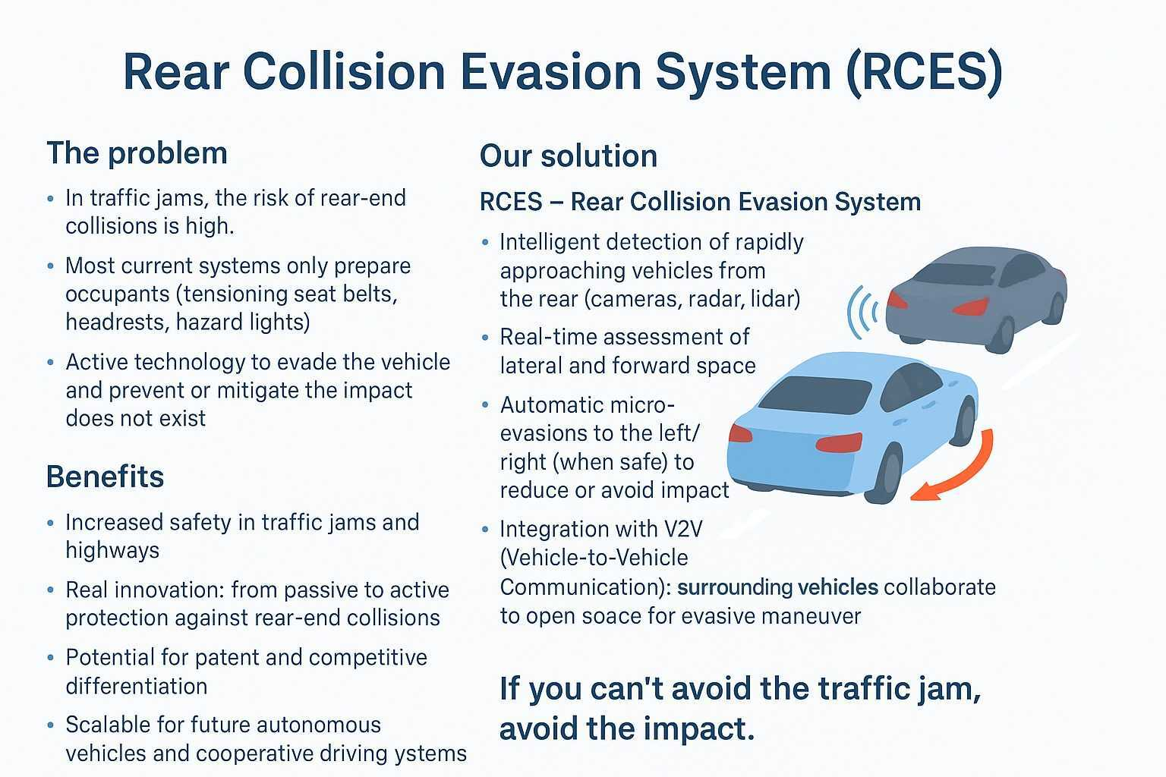
The Product / Service / Added Value
Besides being a revolutionary solution, not yet implemented anywhere else, the real added value is this system can also effectively save lives.

Slide 7
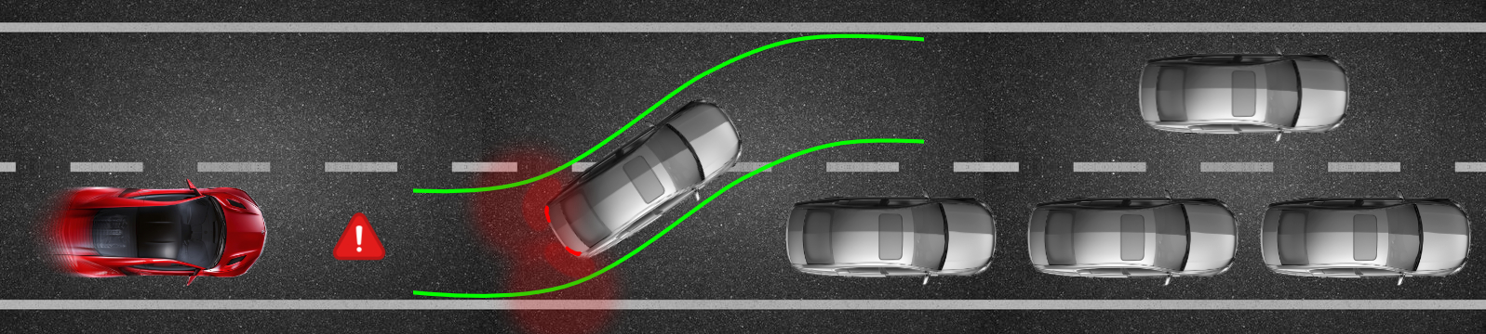
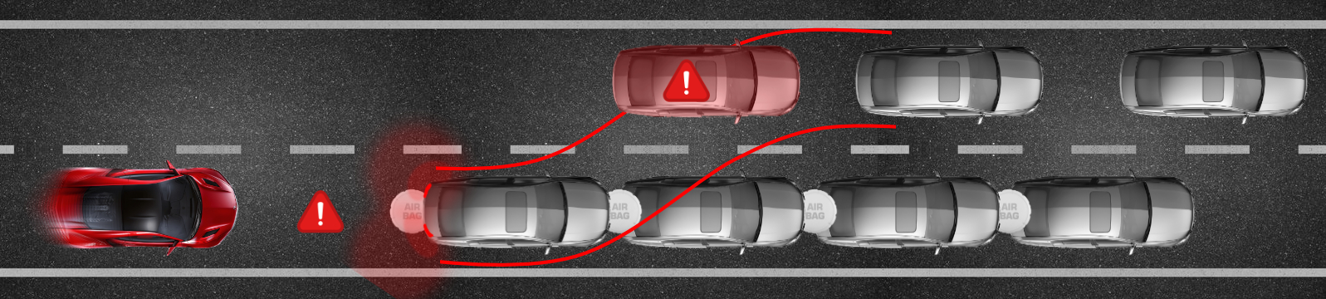

How it works
If there are vehicles in front of the car, the system will attempt to steer the car into an adjacent lane (either to the right or left), if that lane is available for the maneuver.
If no adjacent lane is available, the cars will prepare for the collision by unlocking the brakes and attempting to distribute the force of the impact across all involved vehicles, minimizing the damage.

Slide 8
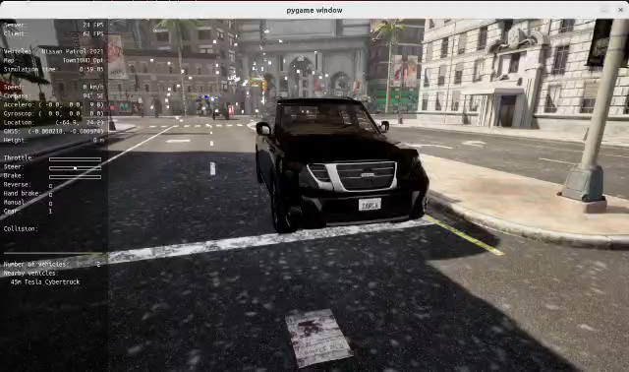
How it works – Video 1

Slide 9
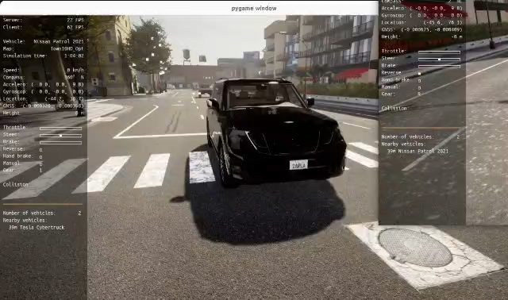
How it works – Video 2

Slide 10
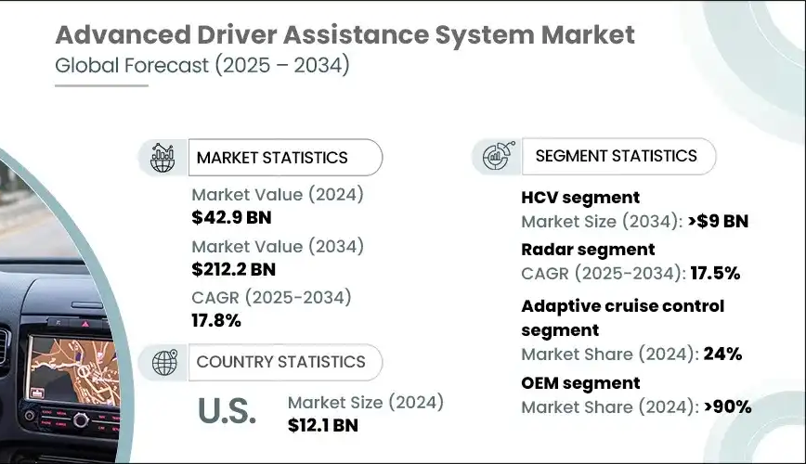
The Market & The Competition
1. Market & Market Size
Market Opportunity
Automotive Safety Systems Market (ADAS & Active Safety)
Global market size (2024): $42B+
Expected growth: CAGR ~10% until 2030
Driven by regulation (EU NCAP, NHTSA, UN ECE standards) and consumer demand for safer vehicles.
Competitors
Indirect: Current ADAS providers (Bosch, Mobileye, Continental) focus on front/side collision avoidance and emergency braking, not rear collision evasion.
Direct: None offering an active rear collision avoidance maneuvering system — this is a white space opportunity.

Slide 11
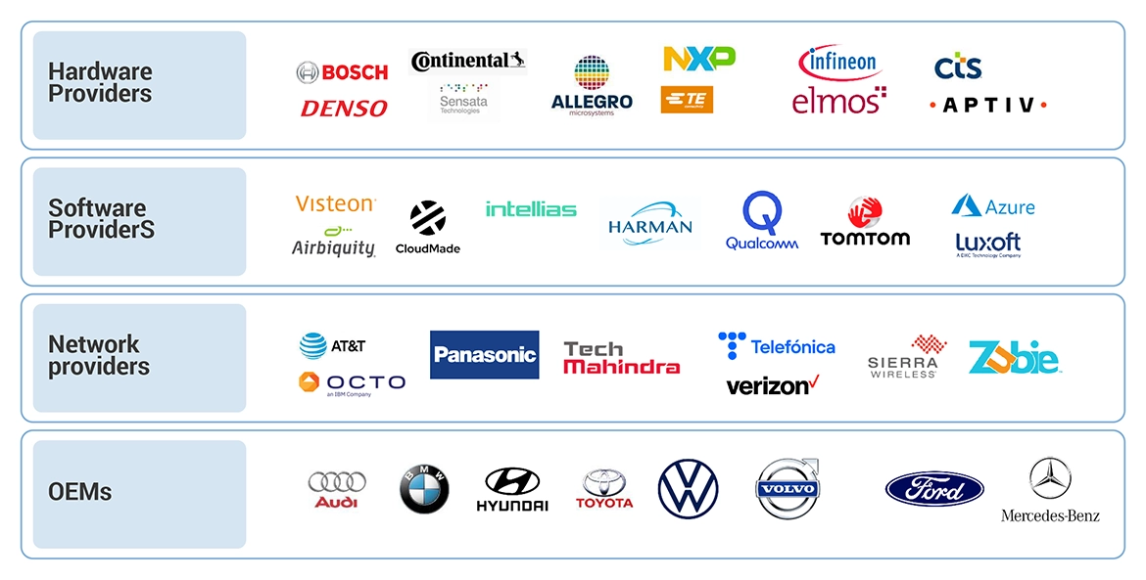
The Market & The Competition
Target Customers
OEMs (Original Equipment Manufacturers): Car makers like Mercedes, BMW, Tesla, Toyota, VW, Hyundai.
Tier 1 Suppliers: Bosch, Continental, ZF, Valeo — companies that integrate new safety tech into vehicles.
Aftermarket & Fleet Operators: Possibility of retrofitting fleet vehicles (taxis, logistics, ride-sharing).

Slide 12
The Market & The Competition
Our Differentiation:
Active evasion system → prevents or reduces the collision
B.A.L.S. integrates communication for cooperative safety
Adaptive real-time micro-maneuvers (steering & brake release to maximize force distribution.
(Business) Opportunity
Current solutions are passive → they only prepare occupants (seatbelts, headrests, hazard lights)
Governments and insurers increasingly demand safety-first technology
Global push for road safety and autonomous driving Technologies
Increasing adoption of ADAS (Advanced Driver Assistance Systems) in all vehicle segments
Potential integration into future autonomous cars and fleet management systems

Slide 13
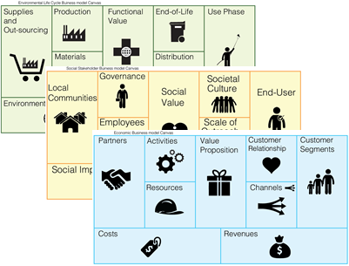
Business Model * Plan & Funds
2. Business Model
Licensing to OEMs: License RCES software + hardware integration kits to car manufacturers.
Partnerships with Tier 1 suppliers: Collaborate with Bosch, Continental, ZF, or Valeo to embed RCES into their existing ADAS platforms.
Retrofit Kits (long-term): Hardware/software retrofit for fleet vehicles (logistics, taxis, ride-hailing, buses).
Revenue Streams:
Licensing fees per vehicle
Long-term royalties (per unit sold with RCES)
Potential SaaS extension for V2V communication (subscription for fleet connectivity).

Slide 14
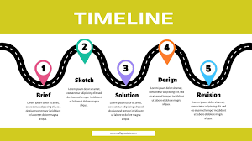
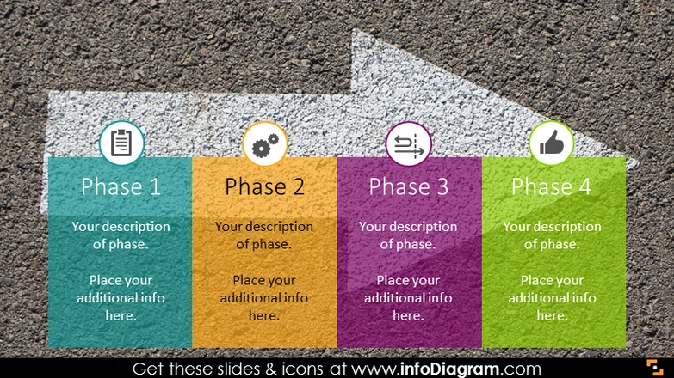
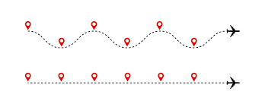
Business Model * Plan & Funds
3. Implementation Plan
Phase 1 – Concept & Prototype (0–12 months)
Simulation in CARLA + AI-based trajectory planning.
Proof-of-concept with RADAR + camera + micro-evasive maneuvering algorithms.
Phase 2 – Pilot & Testing (12–24 months)
Build partnerships with universities / automotive labs.
Test on real vehicles (retrofit kit with RADAR + ECUs).
Safety validation under EuroNCAP crash test protocols.
Phase 3 – Industrial Partnerships (24–36 months)
Collaborate with Tier 1 suppliers for system integration.
File patents on RCES algorithms and V2V integration.
Begin pilot integration with 1–2 OEMs.
Phase 4 – Commercial Rollout (36+ months)
Launch RCES as an embedded system in new vehicles.
Retrofit kits for fleets in parallel.

Slide 15



Business Model * Plan & Funds
40% – Research & Development
30% – Pilot testing & certification with partners
20% – Business development & partnerships
10% – Legal, patents & regulatory approvals
4. Investment Needs
Seed Stage (Year 1–2): ~€2–3M
R&D & Talent: Hire AI engineers, automotive software developers, safety experts.
Hardware: RADAR, LIDAR, ECUs, testing vehicles.
Simulation & Validation: CARLA infrastructure, real-world prototyping.
IP Protection: Patent filing and legal costs.
Series A (Year 2–3): ~€10–15M
Pilot Programs with OEMs and Tier 1 suppliers.
Regulatory Compliance (EuroNCAP, NHTSA validation).
Scaling R&D for V2V integration.
Series B (Year 3–5): ~€30M+
Commercial Partnerships with OEMs.
Mass production readiness.
Retrofit solutions for fleet market.

Slide 16

Business Model * Plan & Funds
Market: €40B+ growing, with a white space (no active rear collision evasion tech today).
Clients: OEMs, Tier 1 suppliers, fleets.
Business Model: Licensing + partnerships + retrofit kits.
Plan: Prototype → Pilot → Partnerships → Commercial launch.
Investment: Initial €2–3M for R&D + IP, scaling to €30M+ for commercial rollout.
Sources: - https://www.grandviewresearch.com/industry-analysis/advanced-driver-assistance-systems-adas-market - https://www.mordorintelligence.com/industry-reports/advanced-driver-assistance-systems-market?utm_ - https://www.globenewswire.com/en/news-release/2023/04/25/2653472/0/en/ADAS-Market-worth-65-1-billion-by-2030-Exclusive-Report-by-MarketsandMarkets.html?utm_ - https://www.gminsights.com/industry-analysis/adas-market/amp?utm

Slide 17

Contact
Name | GitHub
Bruno Miguel | @Bruno0798
Rui Almeida | @Rmsa42
Miguel Biltes | @Biltes
João Silva | @jpjpcs
Bernardo Esteves | @berestv

Slide 18
Thank You!
PortoMotive, delivering Portoble solutions for life.
COPYRIGHT (C) 2025, ECLIPSE FOUNDATION

